Slide 1
Differentiable programming for modeling and control of dynamical systems
Invited talk, Brown University, virtual
Ján Drgoňa Collaborators: Aaron Tuor, James Koch, Shrirang Abhyankar, Ethan King, Wenceslao Shaw Cortez, Sayak Mukherjee, Mahantesh Halappanavar, Draguna Vrabie

Slide 2
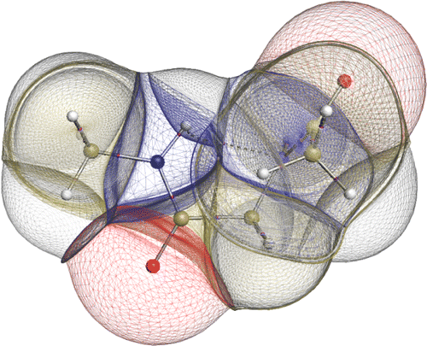

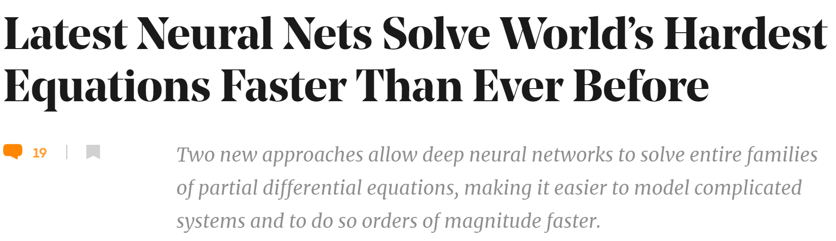

Challenges of Simulation Models
Simulations are crucial for many areas of decision-making and scientific discovery
Need: Improve computational efficiency and scalability for heterogenous scientific simulations
Challenges:
Data-driven predictive modeling and verification
Simulation of complex multi-scale systems of systems
Optimal control and design of complex systems
Emerging solution:
Scientific Machine Learning connecting physics and AI domains

Slide 3

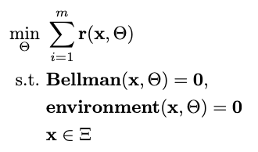

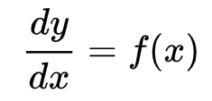

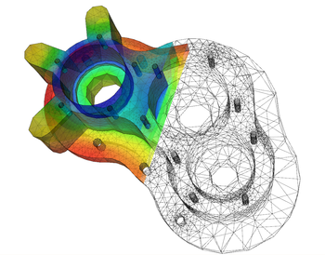
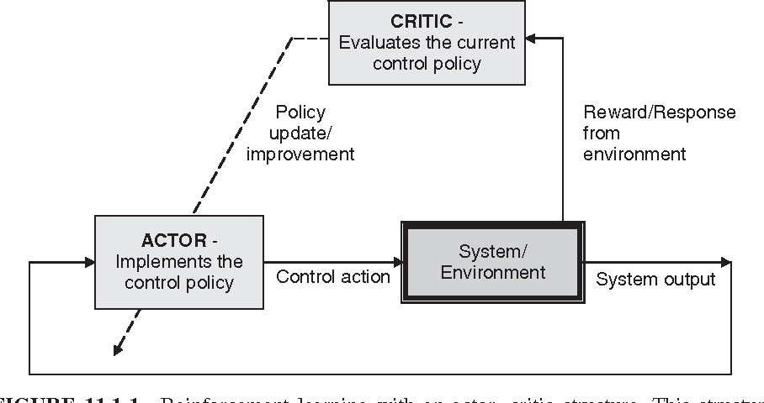

Landscape of Solution Methods
Constrained optimization
Differential equations
Supervised Learning
Reinforcement Learning
Requires prior knowledge of objective function and constraints
Requires prior knowledge of the physics to be modeled
Requires large labeled datasets
Requires environment model to sample
More domain knowledge
Less domain knowledge

Slide 4









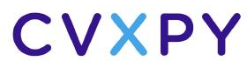


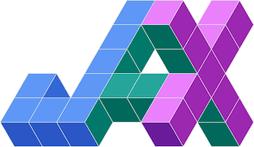



Landscape of Solution Tools
Constrained optimization
Differential Equations
Supervised Learning
Reinforcement Learning
More domain knowledge
Less domain knowledge

Slide 5
Landscape of Solution Tools
Online optimization
Differential Equations
Supervised Learning
Reinforcement Learning
What comes next? … Differentiable programming (DP): a unifying approach for data-driven modeling and optimization of complex systems based on automatic differentiation (AD)

Slide 6
Differentiable Programming Enables Scientific Machine Learning
Differentiable Programming
M. Innes, et al., A Differentiable Programming System to Bridge Machine Learning and Scientific Computing, 2019
Physics-informed Neural Networks
M. Raissi, et al., Physics-informed neural networks: A deep learning framework for solving forward and inverse problems involving nonlinear partial differential equations, 2019
Neural Differential Equations
R. T. Q. Chen, et al., Neural Ordinary Differential Equations, 2019
C. Rackauckas , et al., Universal Differential Equations for Scientific Machine Learning, 2021
Differentiable Optimization
A. Agrawal, et al., Differentiable Convex Optimization Layers, 2019
P. Donti, et al., DC3: A learning method for optimization with hard constraints, 2021
S. Gould, et al., Deep Declarative Networks: A New Hope, 2020
J. Kotary, et al., End-to-End Constrained Optimization Learning: A Survey, 2021
Differentiable Control
B. Amos, et al., Differentiable MPC for End-to-end Planning and Control, 2019
S. East, et al., Infinite-Horizon Differentiable Model Predictive Control, 2020

Slide 7
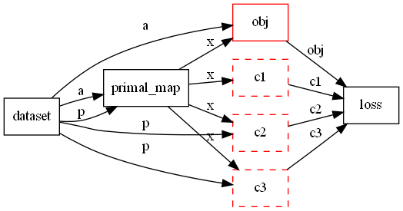
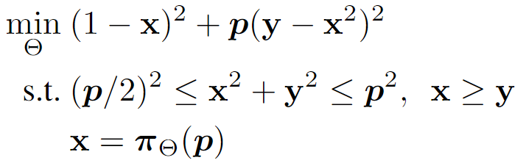
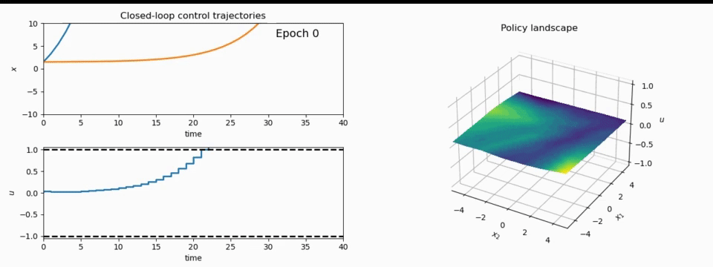
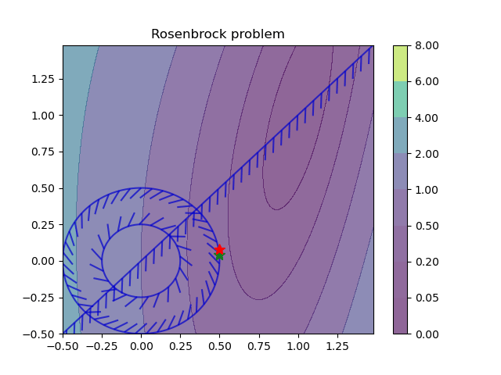
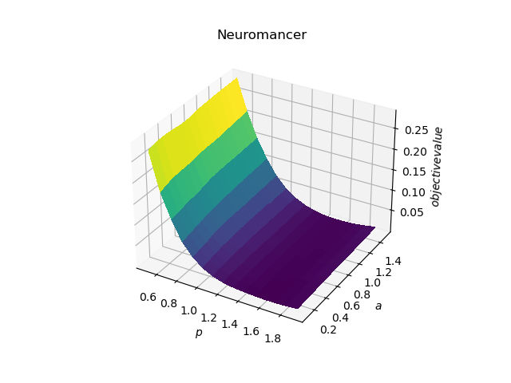
NeuroMANCER: a Scientific Machine Learning Library
1. Mathematical formulation
3. Problem graph
map
2. Python code interface
4. Results
import neuromancer as nm
p = nm.constraints.variable(‘p’)
x = nm.constraints.variable(‘x’)
y = nm.constraints.variable('y’)
obj = ((1-x)**2 + p*(y-x**2)**2).minimize(weight=1.0, name='obj’) c1 = (p/2)**2 <= x**2 + y**2
c2 = x**2 + y**2 <= p**2
c3 = x >= y net = nm.blocks.MLP(insize=2, outsize=2, hsizes=[80]*4) map = nm.maps.Map(net, input_keys=['p’], output_keys=[‘x’,‘y’])
loss = nm.loss.PenaltyLoss([obj], [c1, c2, c3]) problem = nm.problem.Problem([map], loss)
optimizer = torch.optim.AdamW(problem.parameters()) trainer = nm.Trainer(problem,data,optimizer)
best_model = trainer.train()

Slide 8
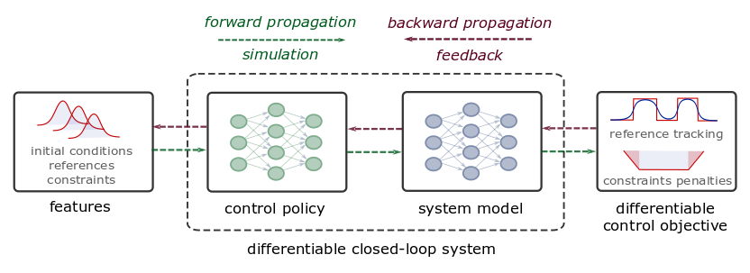
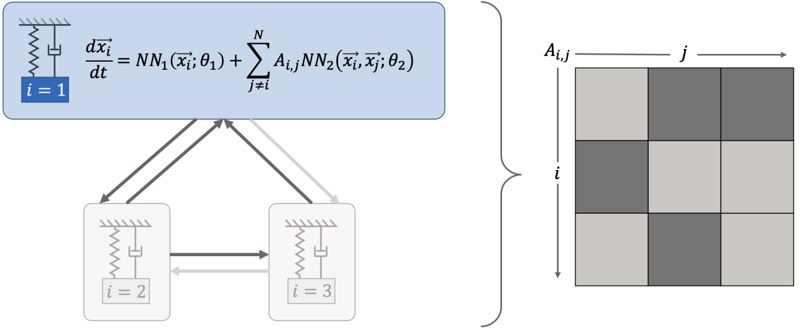
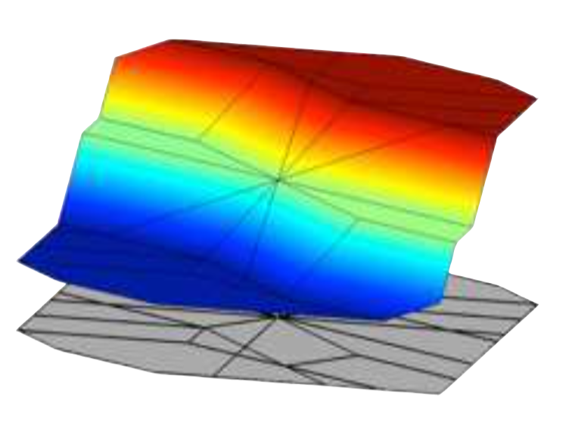
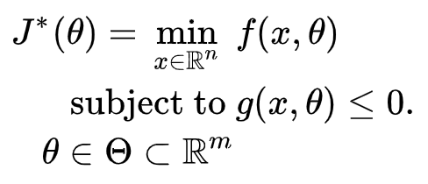
Data-driven Modeling Capabilities in Neuromancer
Component-based Physics-informed Machine Learning
Differentiable control
Graph and network neural differential equations
Parametric constrained optimization

Slide 9
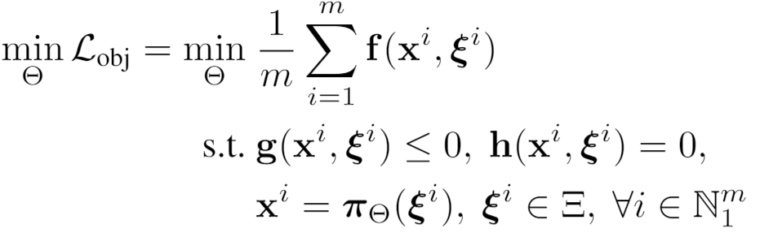
Parametric Optimization via Differentiable Programming
Problem formulation:

Slide 10
Parametric Optimization via Differentiable Programming
Objective function
Problem formulation:
Constraints
Primal optimizers
Scenarios
Solution map
Parameters

Slide 11
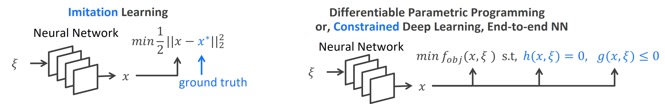
Parametric Optimization via Differentiable Programming
Objective function
Problem formulation:
Constraints
Primal optimizers
Scenarios
Solution map
Parameters

Slide 12
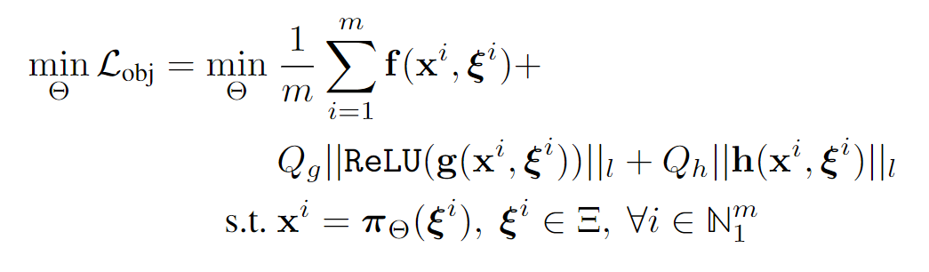
Parametric Optimization via Differentiable Programming
Objective function
Problem formulation:
Constraints
Primal optimizers
Scenarios
Solution map
Parameters
Lagrangian form:
Constraints penalties
Gradient-based optimization based on AD

Slide 13
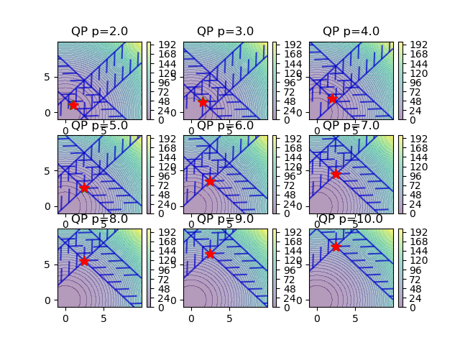
Parametric Optimization Examples
Nonlinear program
Quadratic program

Slide 14
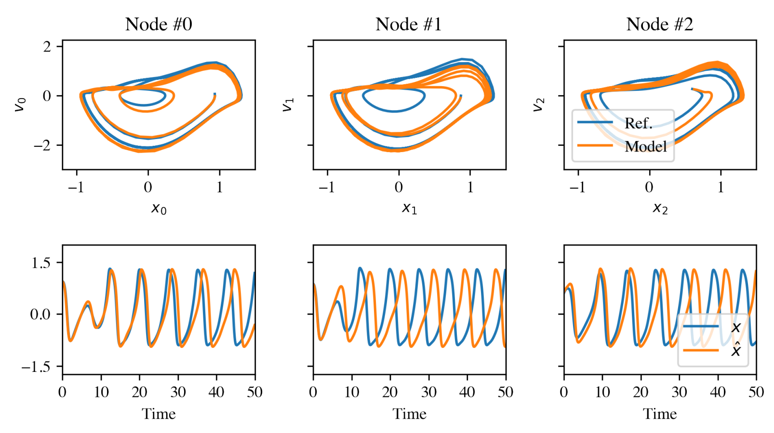
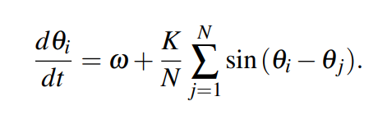
Networked Dynamical Systems via Universal Differential Equations
Network of unknown oscillators
Coupling adjacency
Generalization of learned dynamics on never-seen network topology.
Ground truth Kuramoto system:
James Koch, et al., Structural Inference of Networked Dynamical Systems with Universal Differential Equations, Chaos: An interdisciplinary Journal of Nonlinear Science, doi.org/10.1063/5.0109093, 2023

Slide 15
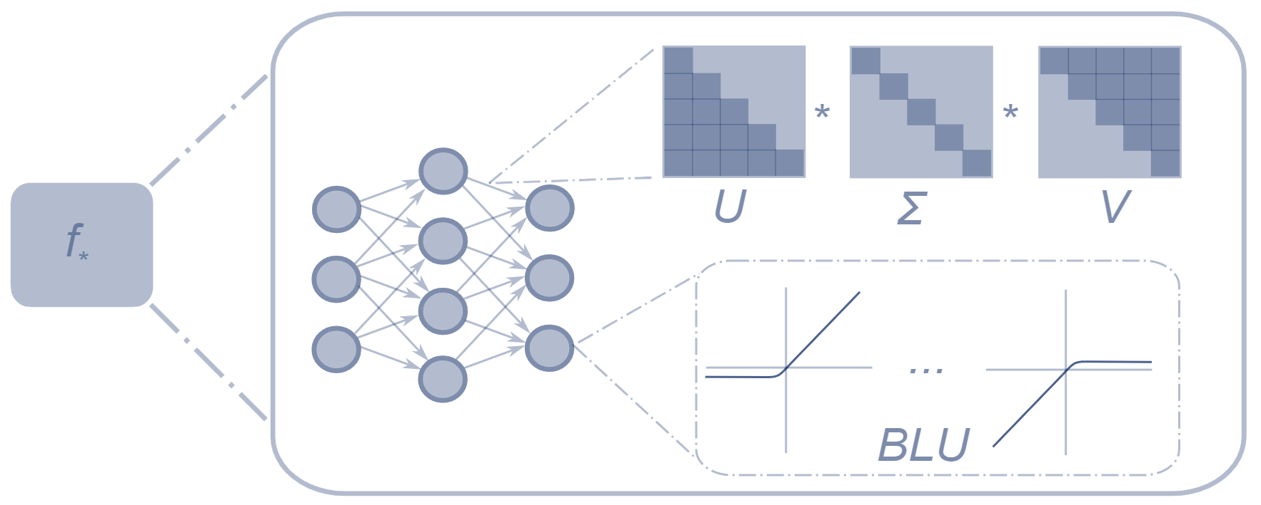
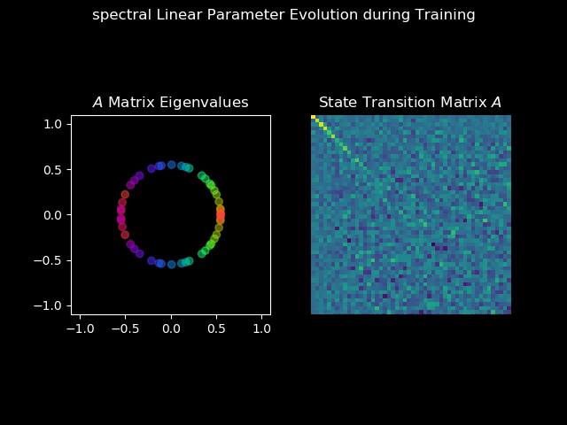
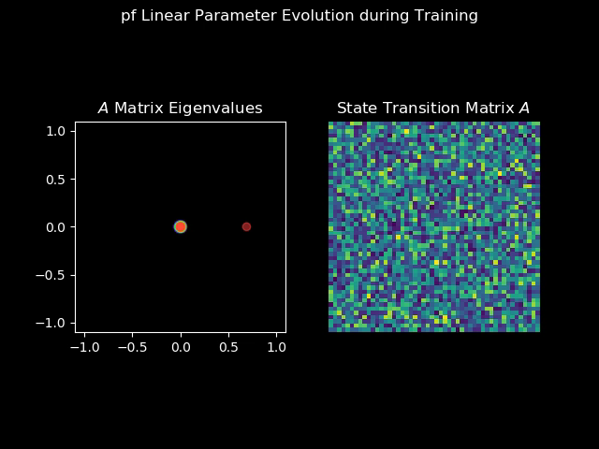
Structured Linear Maps (SLiM)
Factorizations and regularizations of linear maps with predetermined structure
Can be used to enforce sparsity, spectral properties, or other linear algebra properties
Spectral map
Perron-Frobenius map
https://github.com/pnnl/slim

Slide 16
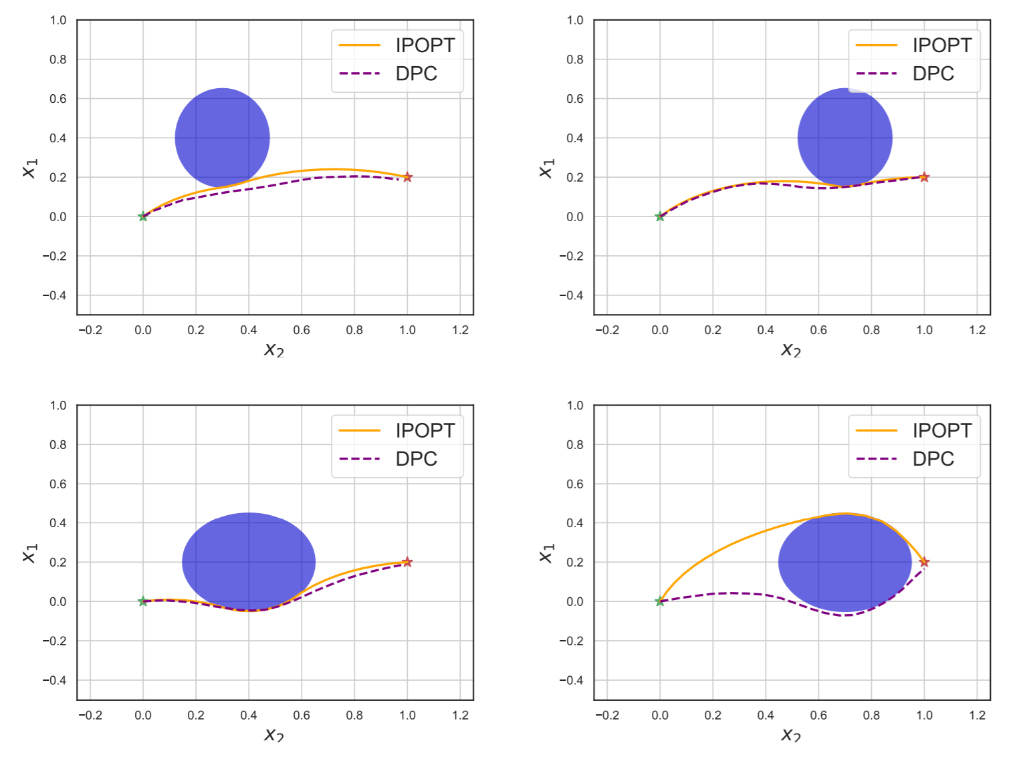
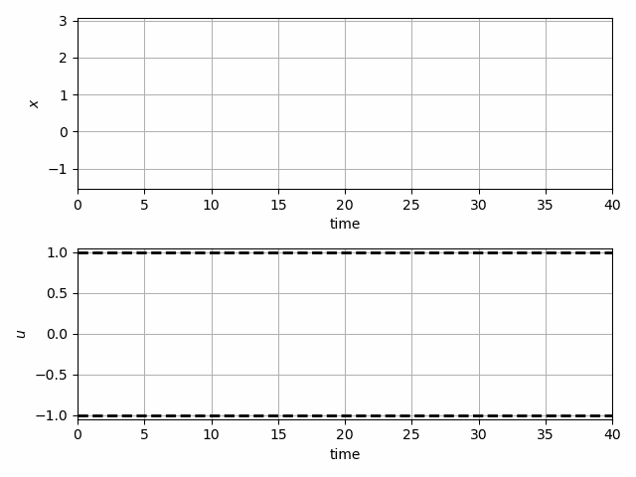
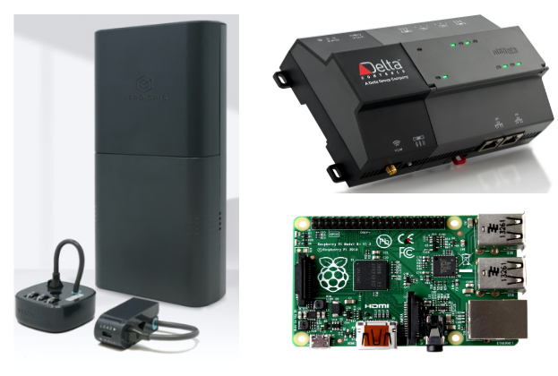
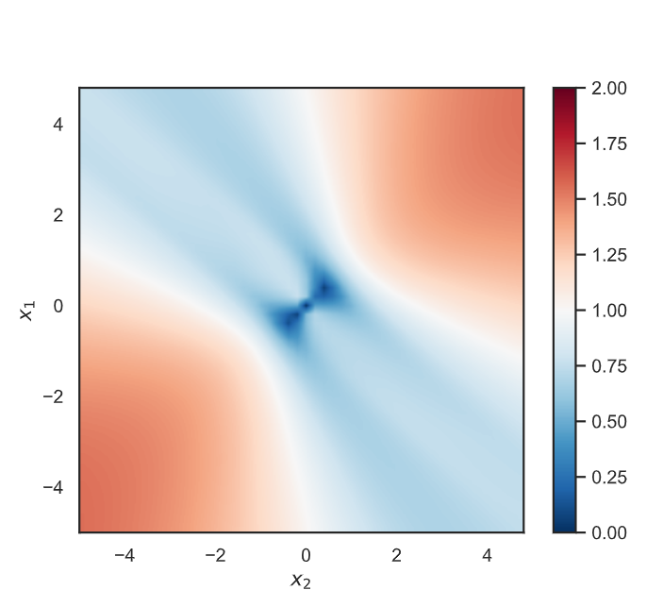
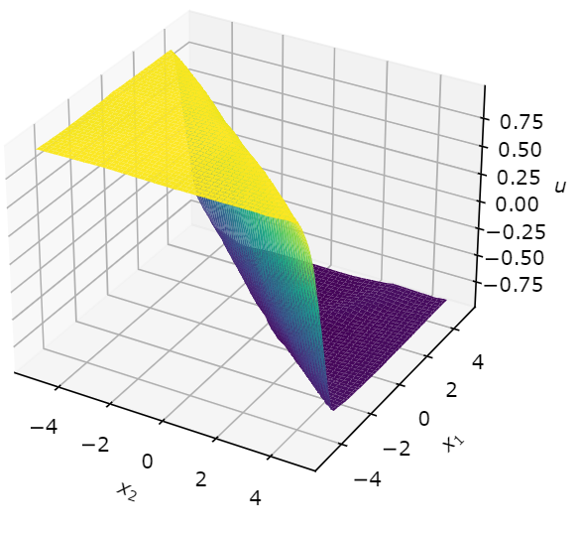

Optimal Control Capabilities in Neuromancer
Trajectory optimization and obstacle avoidance
Stability analysis and guarantees
Code generation and edge deployment for automated scientific experiments – under development

Slide 17
Differentiable Predictive Control (DPC)
Optimal control of differentiable digital twin models
Optimization over design parameters representing different scenarios
Differentiable system model allows for counterfactual reasoning based on forward simulations
Evaluate quality of the soliton based on domain specific metrics
Jan Drgona, et al., Differentiable Predictive Control: An MPC Alternative for Unknown Nonlinear Systems using Constrained Deep Learning, Journal of Process Control, 2022

Slide 18
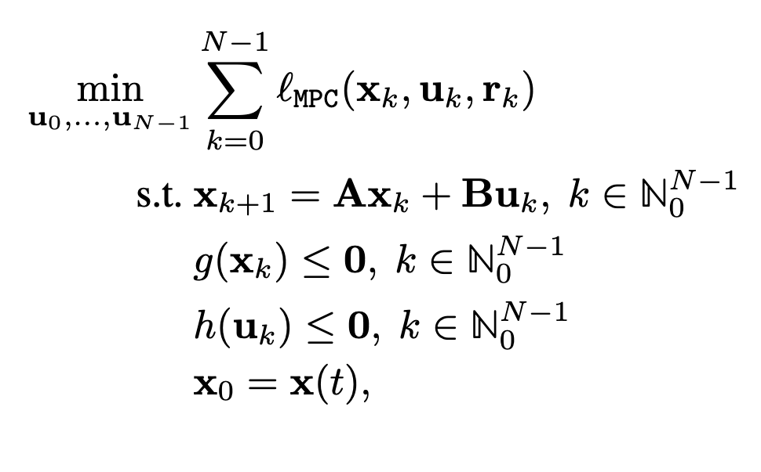
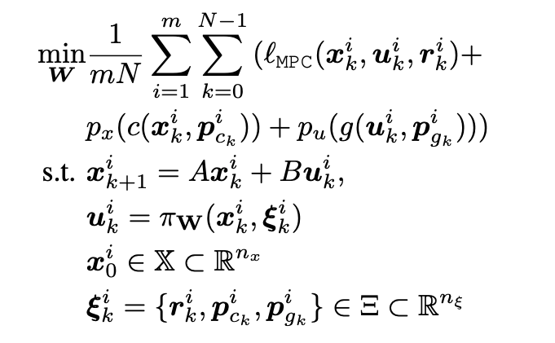
Differentiable Predictive Control (DPC)
From data to optimized explicit predictive control policy
MPC
DPC
Cost:
Model:
Constraints:
Online optimization
Optimize for control actions
Implicit solver-based control policy
Offline optimization
Optimize for control policy parameters
Explicit neural control policy
Jan Drgona, et al., Differentiable Predictive Control: An MPC Alternative for Unknown Nonlinear Systems using Constrained Deep Learning, Journal of Process Control, 2022

Slide 19
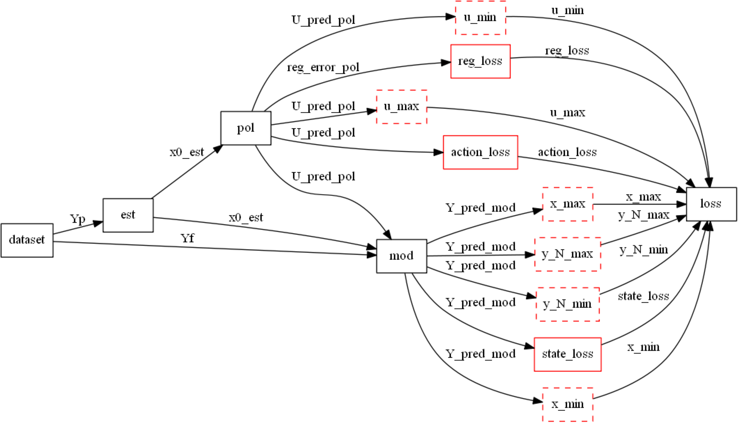
Differentiable Computational Graphs and Model-based Policy Gradients
Constructing differentiable computational graph: implementing parametric MPC problem in NeuroMANCER.
https://github.com/pnnl/neuromancer

Slide 20
Differentiable Computational Graphs and Model-based Policy Gradients
Forward pass: evaluate graph components (policy, model, constraints, objective terms) to compute structured learning loss function.
https://github.com/pnnl/neuromancer

Slide 21
Differentiable Computational Graphs and Model-based Policy Gradients
Forward pass: evaluate graph components (policy, model, constraints, objective terms) to compute structured learning loss function.
https://github.com/pnnl/neuromancer

Slide 22
Differentiable Computational Graphs and Model-based Policy Gradients
Forward pass: evaluate graph components (policy, model, constraints, objective terms) to compute structured learning loss function.
https://github.com/pnnl/neuromancer

Slide 23
Differentiable Computational Graphs and Model-based Policy Gradients
Forward pass: evaluate graph components (policy, model, constraints, objective terms) to compute structured learning loss function.
https://github.com/pnnl/neuromancer

Slide 24
Differentiable Computational Graphs and Model-based Policy Gradients
Forward pass: evaluate graph components (policy, model, constraints, objective terms) to compute structured learning loss function.
https://github.com/pnnl/neuromancer

Slide 25
Differentiable Computational Graphs and Model-based Policy Gradients
Forward pass: evaluate graph components (policy, model, constraints, objective terms) to compute structured learning loss function.
https://github.com/pnnl/neuromancer

Slide 26
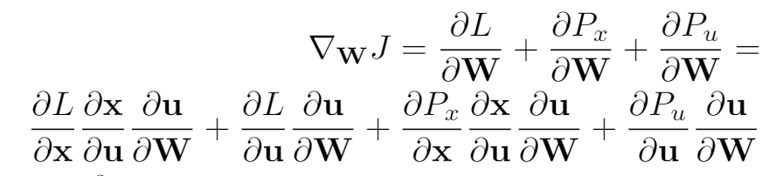
Differentiable Computational Graphs and Model-based Policy Gradients
Backward pass: Differentiate the computational graph to train the policies using automatic differentiation (AD) tools.
https://github.com/pnnl/neuromancer

Slide 27
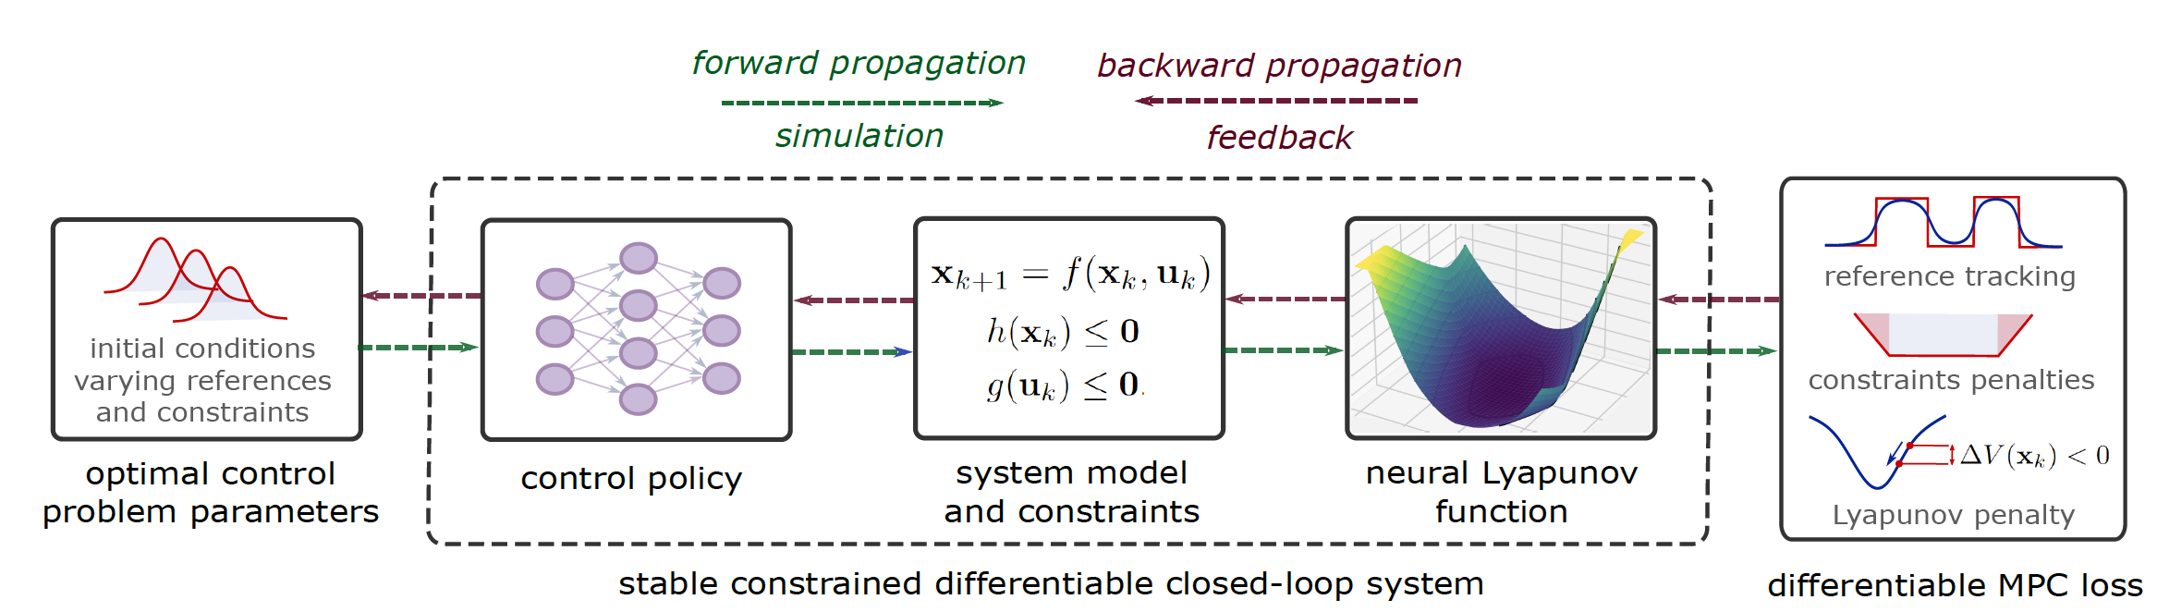
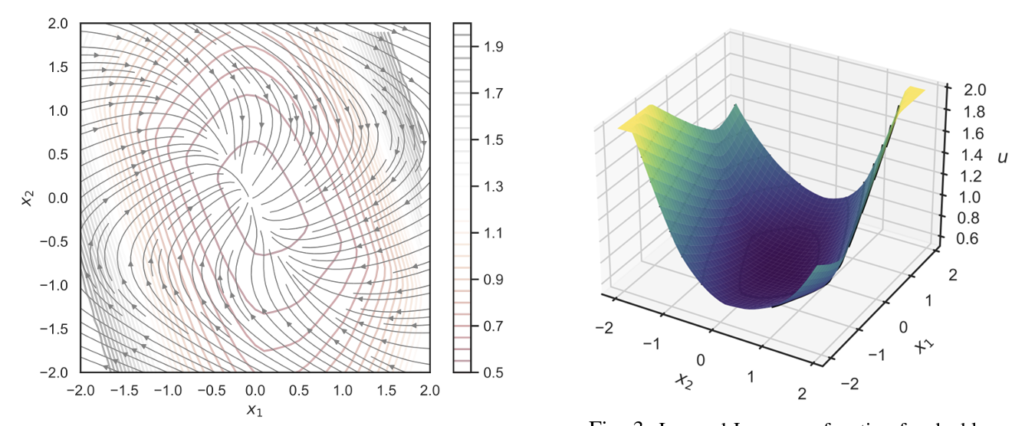
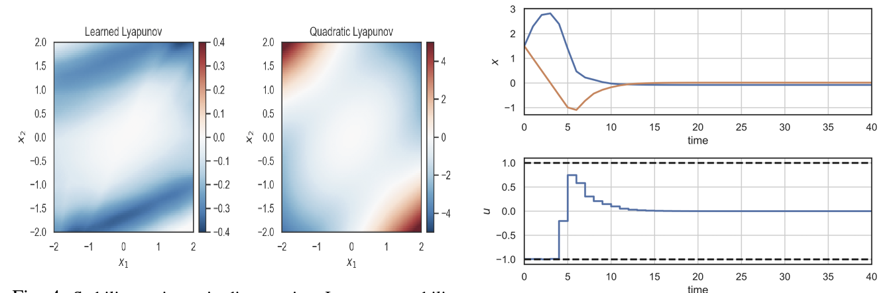
Learning Stable Policies with Neural Lyapunov Functions
Sayak Mukherjee, Ján Drgoňa, Aaron Tuor, Mahantesh Halappanavar, Draguna Vrabie, Neural Lyapunov Differentiable Predictive Control, Conference on Decision and Control (CDC), 2022

Slide 28
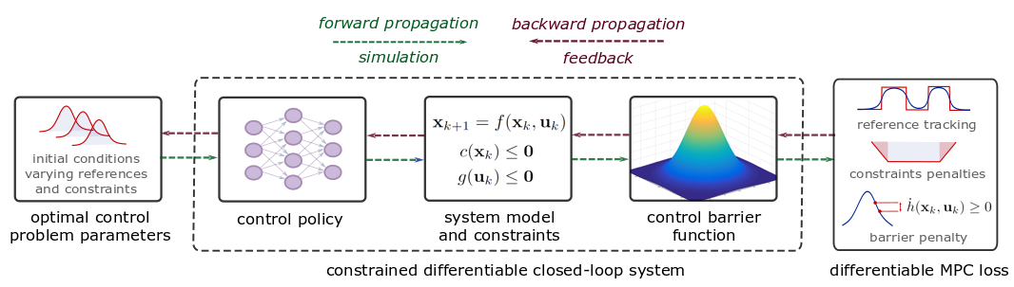
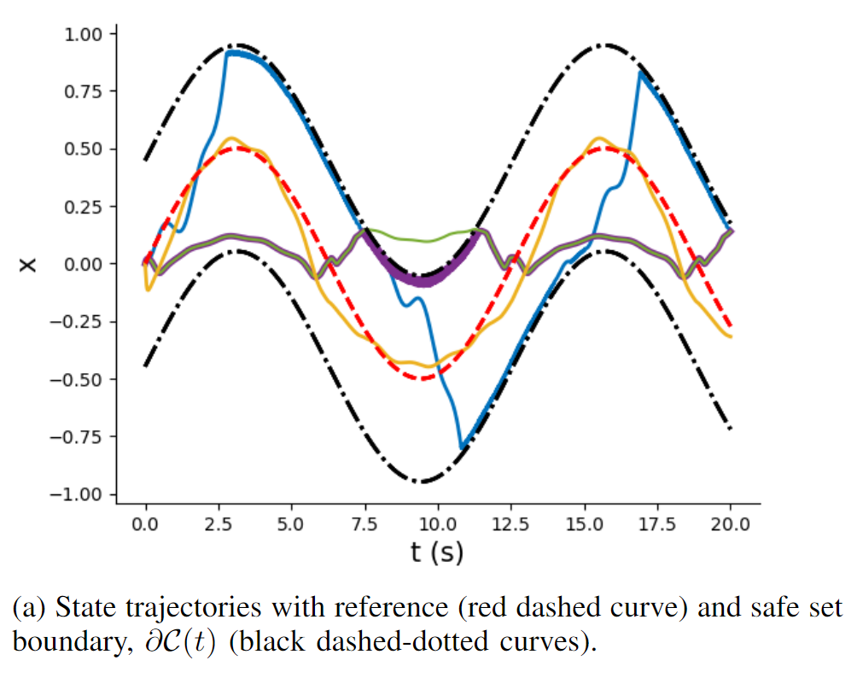
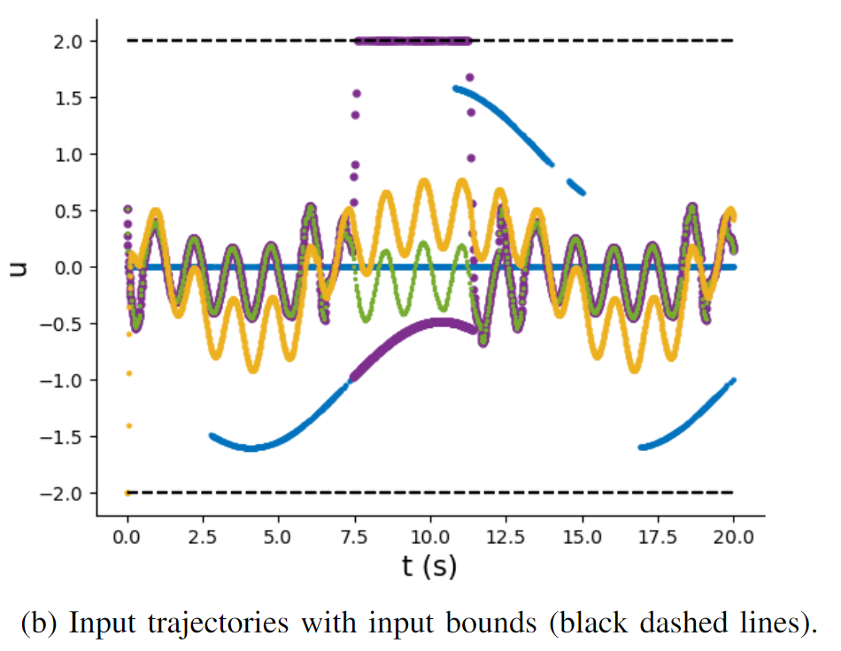
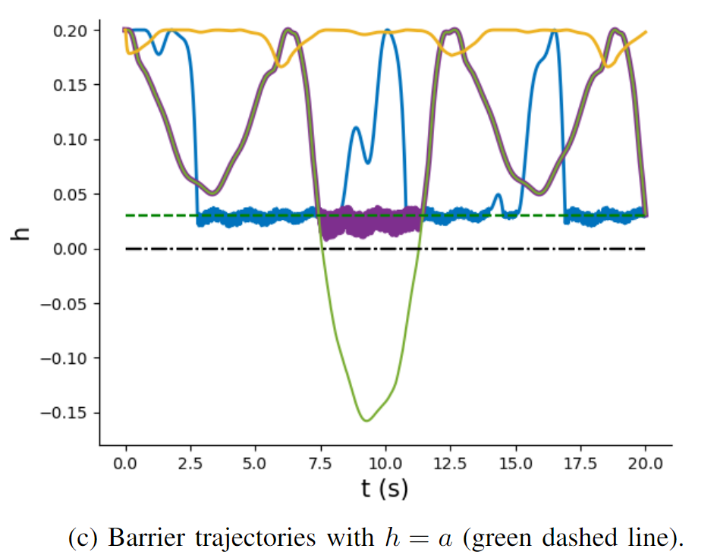
Learning Safe Policies with Control Barrier Functions
Wenceslao Shaw Cortez, et al., Differentiable Predictive Control with Safety Guarantees: A Control Barrier Function Approach, Conference on Decision and Control (CDC), 2022

Slide 29


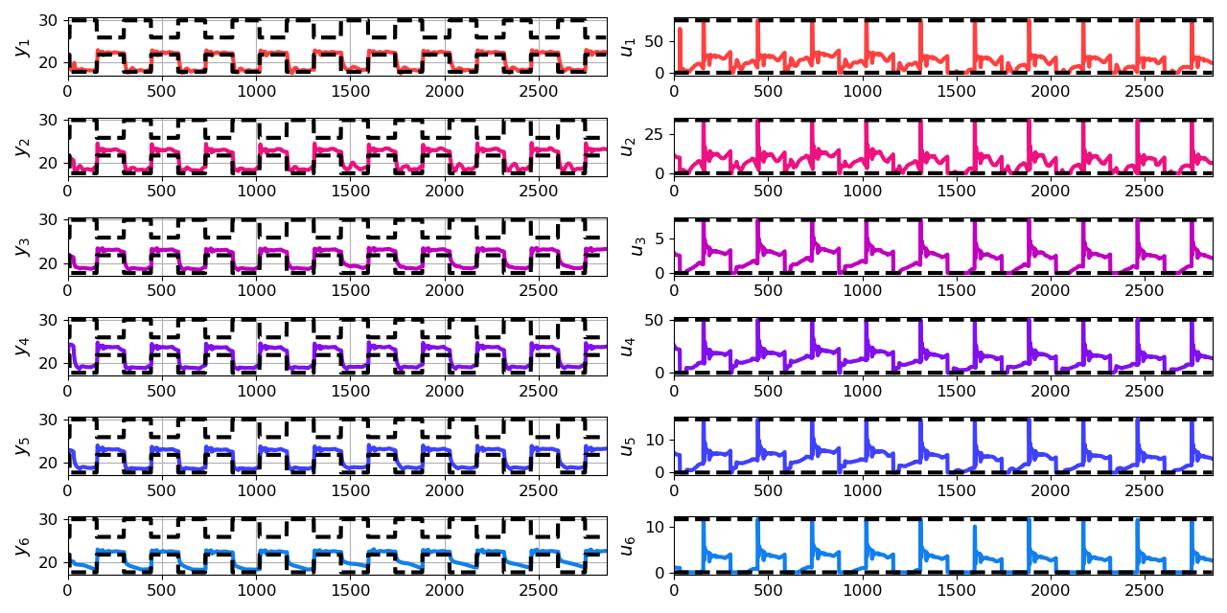
Economic Differentiable Predictive Control of Building Energy System
Architectures
Neural state space dynamics model
MLP control policy architecture
Results
Multi-input multi-output system dynamics
Dynamic economic control objective
Parametric constraints
Jan Drgona, Aaron Tuor, Elliott Skomski, Soumya Vasisht, Draguna Vrabie, Deep Learning Explicit Differentiable Predictive Control Laws for Buildings, IFAC NMPC 2021

Slide 30
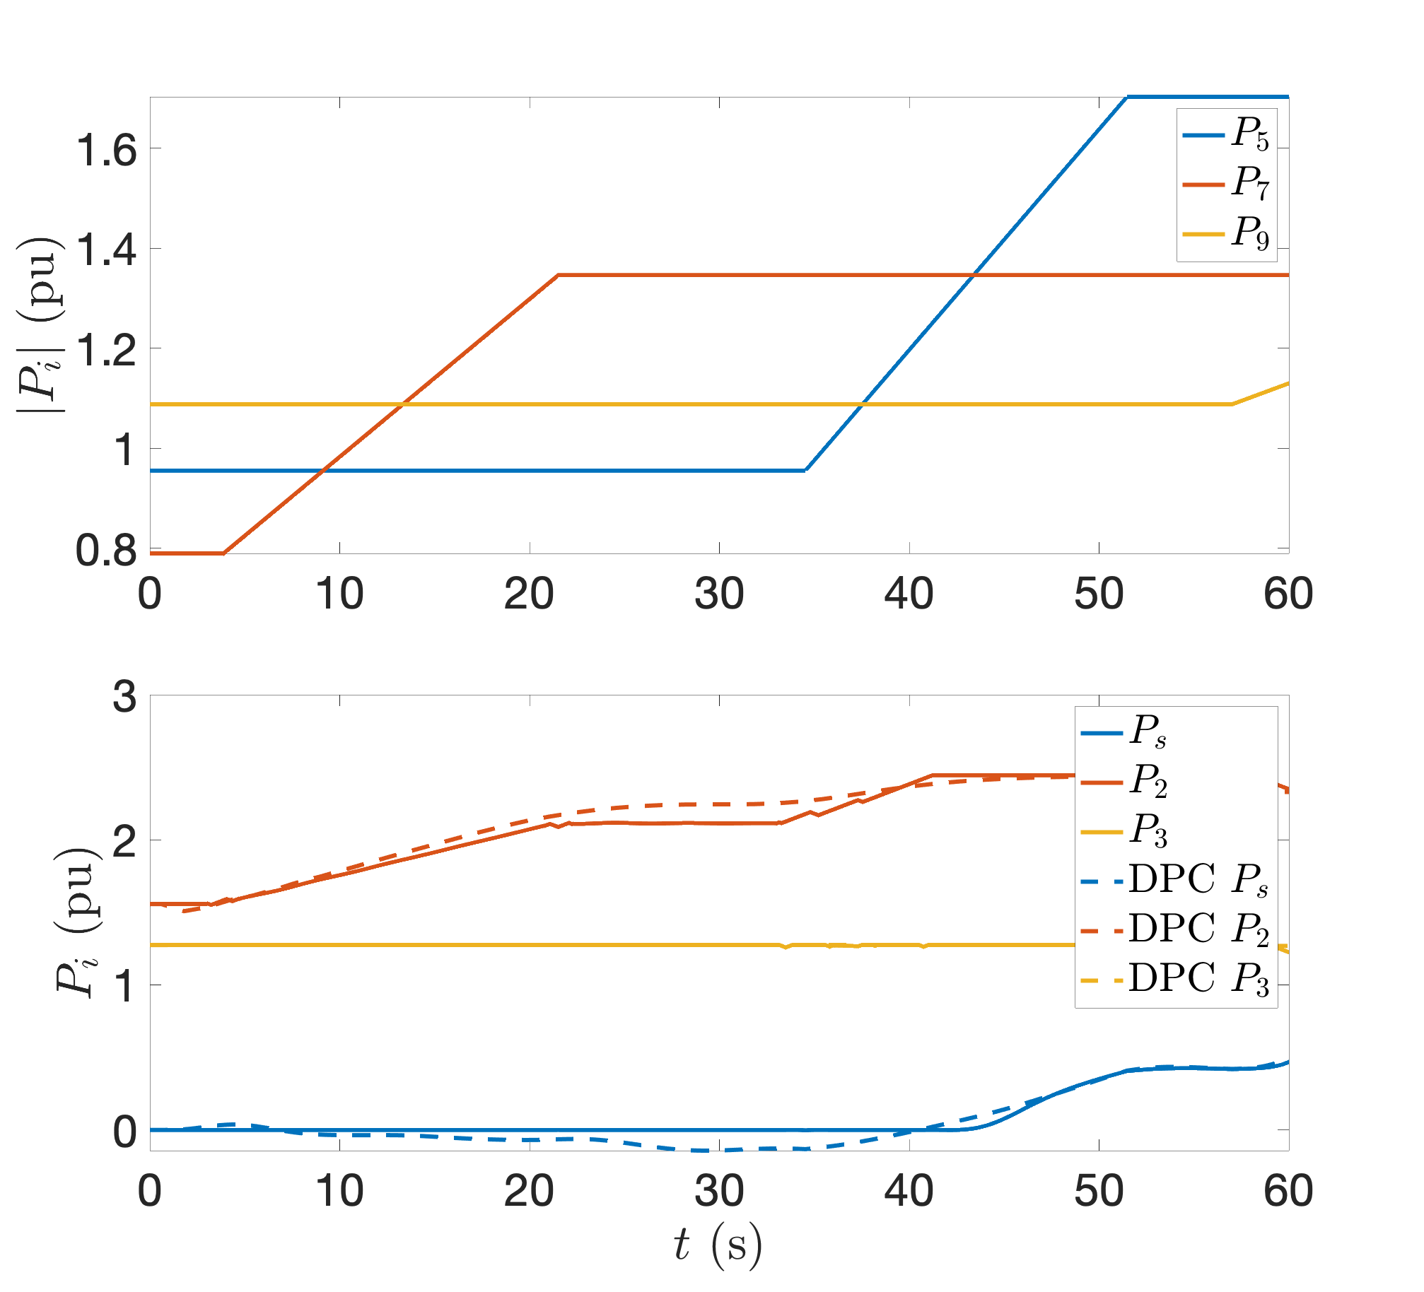
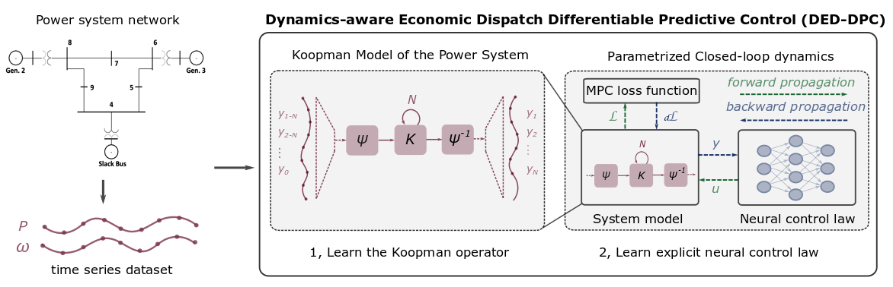
Dynamics-Aware Economic Redispatch via Differentiable Predictive Control
Problem: Current redispatch processes do not incorporate system dynamics concerns. Incorporating dynamics in redispatch is too complex and/or time-consuming
Architectures
Koopman dynamics model
CNN control policy
Solution: Machine-learning based dynamics-aware redispatch. Learn system dynamics and control policies for faster assessment.
Results
5 orders of magnitude speed-up
Near optimal performance
Ethan King, Ján Drgoňa, Aaron Tuor, Shrirang Abhyankar, Craig Bakker, Arnab Bhattacharya, Draguna Vrabie, Koopman-based Differentiable Predictive Control for the Dynamics-Aware Economic Dispatch Problem, 2022 American Control Conference

Slide 31
Edge Deployment of Differentiable Predictive Control
Flexy-Air system sketch with Raspberry-Pi controller
Proof of concept for AI on the edge platform.
Jan Drgona, Karol Kis, Aaron Tuor, Draguna Vrabie, Martin Klauco, Differentiable Predictive Control: An MPC Alternative for Unknown Nonlinear Systems using Constrained Deep Learning; Journal of Process Control, 2022

Slide 32



NeuroMANCER
Open-source scientific machine learning (SciML) toolbox in PyTorch for integrating deep learning, constrained optimization, and physics-based modeling
Physics-informed machine learning
Data-driven modeling of complex systems
Optimal control of complex systems
Constrained optimization for optimal design
github.com/pnnl/neuromancer

Slide 33


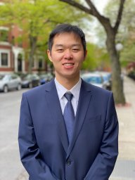

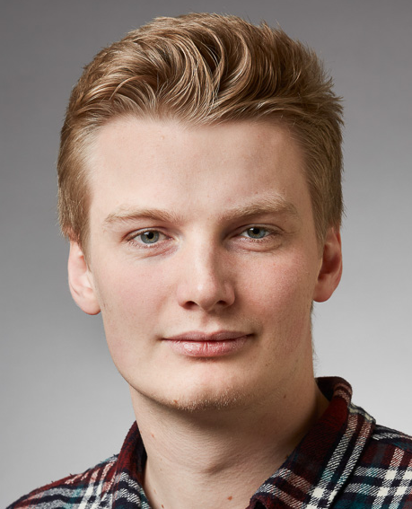



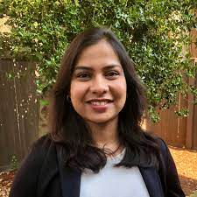



Acknowledgements
Aaron Tuor
James Koch
Zhao Chen
Stefan Dernbach
Christian M. Legaard
Ethan King
Sayak Mukherjee
Wenceslao Shaw Cortez
Soumya Vasisht
Shrirang Abhyankar
Mahantesh Halappanavar
Draguna Vrabie

